Slide 1

CAPSTONE PROJECT (2)
YES BANK STOCKS CLOSING PRICE PREDICTION
TEAM NAME
MD KAMRAN
REENA VERMA
RISHABH GUPTA
KRUNAL SONARE
MITHIN BARDE
ALMA BETTER PROJECT

Slide 2

POINTS TO DISCUSS:
PROBLEM STATEMENT
DATA SUMMARY
DATA CLEANING
DISCUSSION ABOUT EXPLORATORY DATA ANALYSIS
CORRELATION AND VIF ANALYSIS
MODEL TRAINING
CONCLUSION

Slide 3

PROBLEM STATEMENT
HOW WE DID THIS PROJECT
‘YES Bank’ is a well-known bank in the Indian Financial domain. Since 2018, it has been in the news because of the fraud case involving Rana Kapoor.
We are interested to know whether either ML Model can predict the impact on stock price due to this fraud case.
So we have performed regression analysis to make future predictions using various ‘Machine Leaning’ models and selected one model as the best model after comparing them using evaluation matrices and this model will be going to use for future prediction.

Slide 4

DATA SUMMARY
Data Set:- In Yes Bank Stock Price data set contains 185 rows and 5 columns which include Date, Open, High, Low, and Close.
Date:- The date of record finalizes the transfer of the stock's ownership.
Open:- Open Price is the price at which the financial security opens in the market when trading begins. It may or may not be different from the previous day's closing price. The security may open at a higher price than the closing price due to excess demand for the security.
High:- High is the highest price at which a stock is traded during a period.
Low:- Low is the lowest price at which stock is traded during a period.
Close:- The closing price of the stock is the price at which the share closes at the end of trading hours of the stock market.
Let’s Dive In

Slide 5
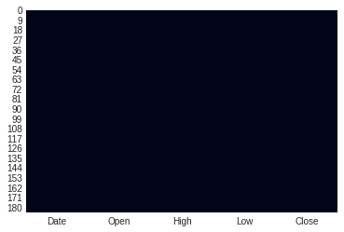
DATA CLEANING
Null value Treatment.
Duplicate Treatment.
Data Format change.
Null value Treatment: In the given dataset no null value was there.
Duplicate Treatment: There was no duplicate data in the dataset.
Data Format change: We have changed the datatype of the Date column from object to time64() format.
LET’S MOVE TO THE EDA PART

Slide 6
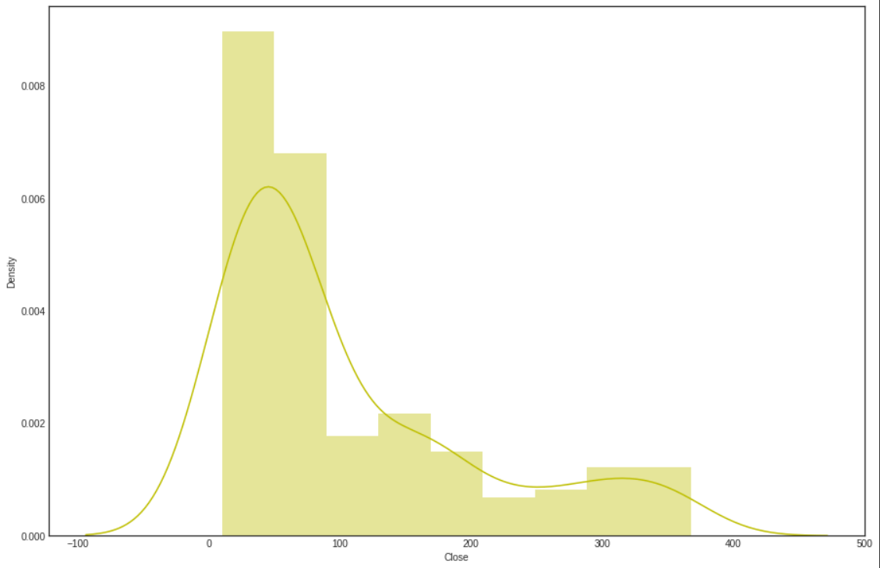
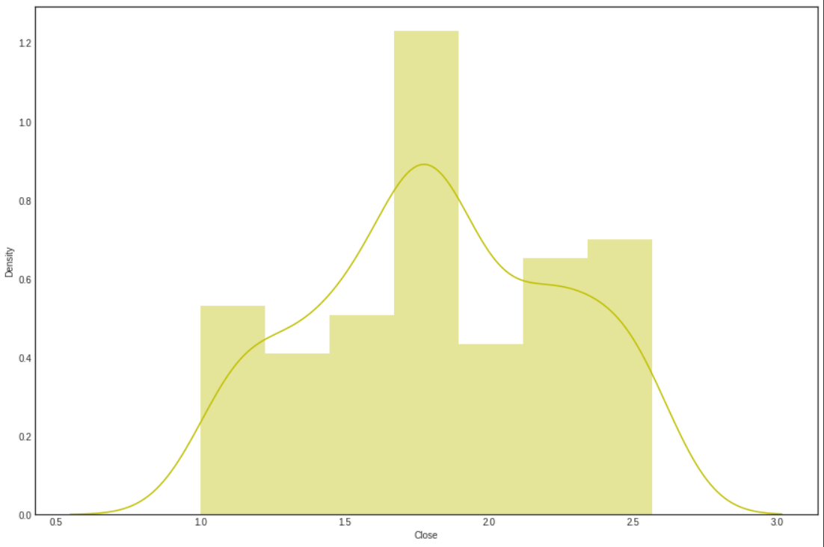
EXPLORATORY DATA ANALYSIS
Distribution of Close:- Distribution of the target variable(Closing Price) was left-skewed so we performed a log transformation to make it normal.
Before log transformation
After log transformation
LET’S MOVE TO THE SKEWNESS-CHECKING PART

Slide 7
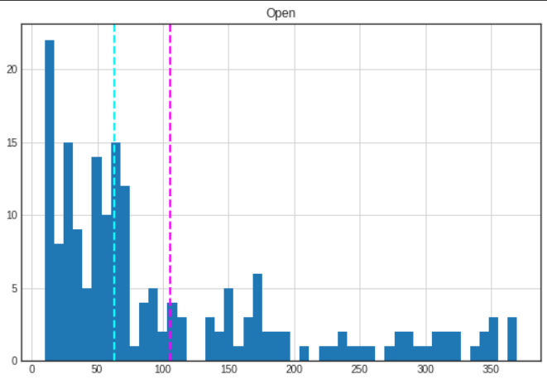
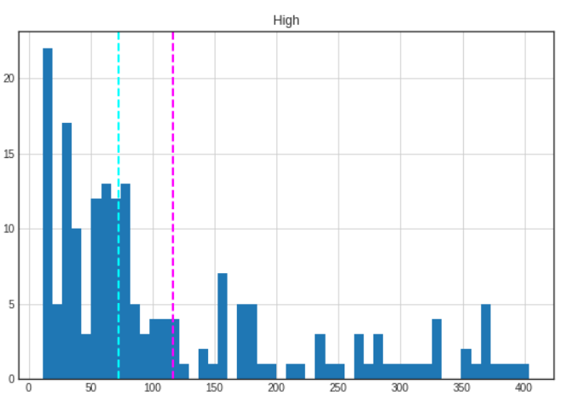
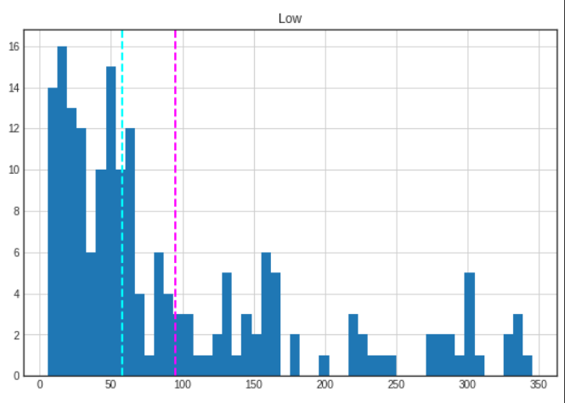

Check for skewness in the dataset
Skewness Checking:
After applying the plot we can easily see the skewness of this data set was left-skewed so again we performed a log transformation to make it normal.

Slide 8
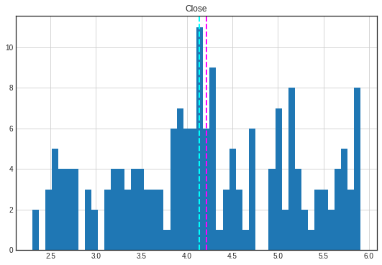
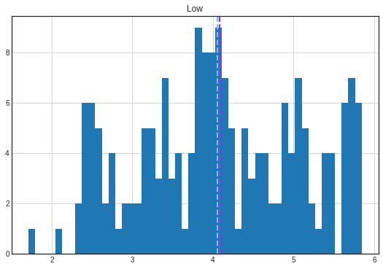
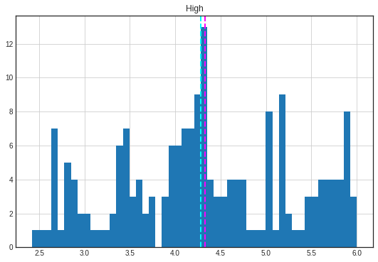
Skewness Checking:
After Performing the log transformation now we can see the result of the skewness of this data set.

Slide 9
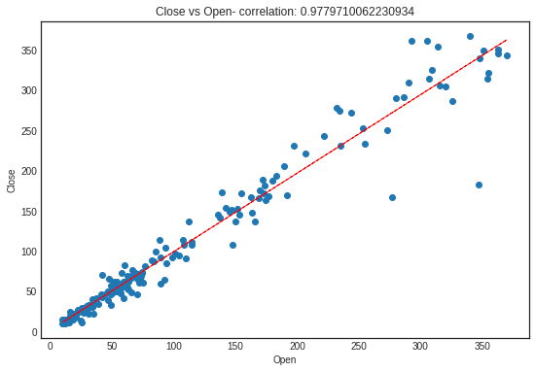
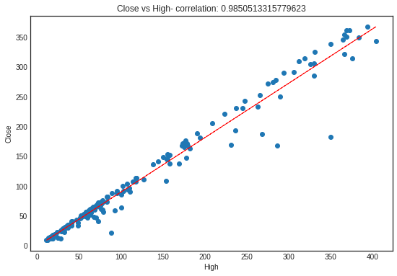
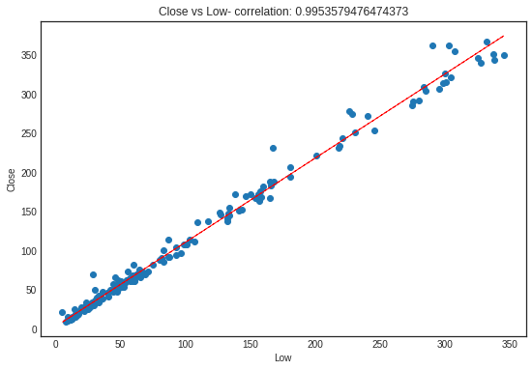
Bivariate Analysis: Now we will see the relationship between dependent and independent variables using a scatter plot.
Close Vs Low
Close Vs Open
Close Vs High

Slide 10
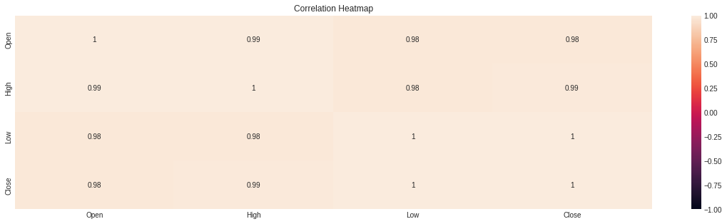
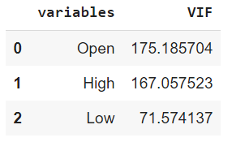
Correlation and vif analysis
We can see that all variables are highly correlated and also we can see that VIF scores are very high for all our features which means there is a multicollinearity between our independent variables.
As we have limited features, dropping any one of them will result in the loss of important data which are essential for accurate model prediction and it will result in a bad model.

Slide 11
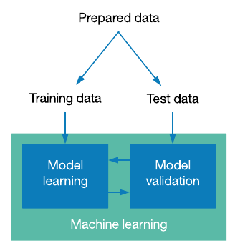
Model Training
Train test split
Train Test Split is used to split the dataset into Train and Test Sets.
Train Set is used to train the model.
Test set is used to test the performance of the model.
80% of data is used to train the model and only 20% is used for testing purposes.

Slide 12
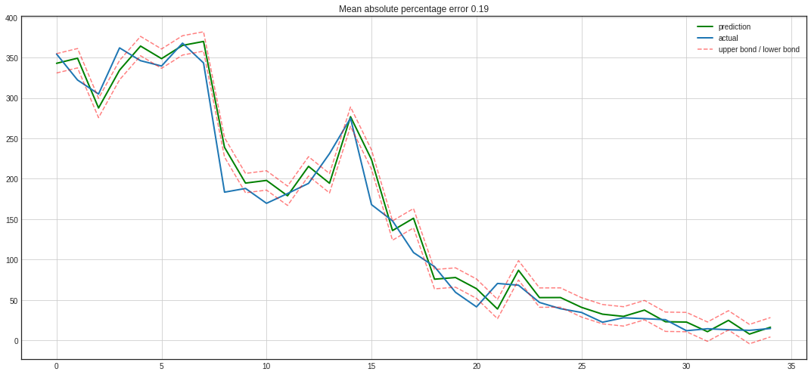
Linear Regression:
Linear regression is a popular and uncomplicated algorithm used in data science and machine learning.
Linear regression shows a linear relationship between dependent and independent variables
mean squared error: 486.35 root mean
squared error: 22.05
r2_score: 0.97
mean absolute percentage error: 0.19

Slide 13
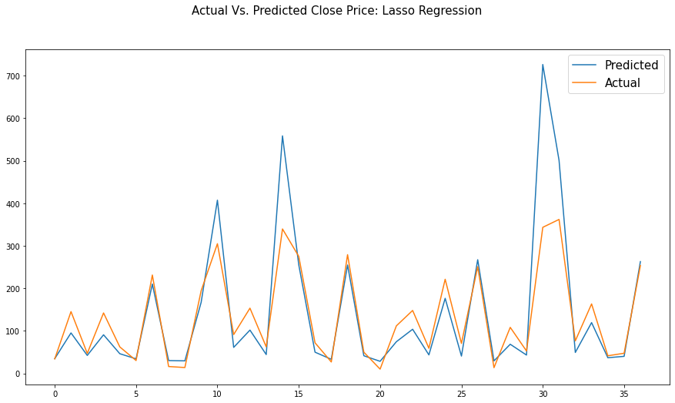
2. Lasso Regression:
It is a regression analysis method that performs both variable selection and regularization in order to enhance the prediction accuracy and interpretability of the model.
This regression performs L1 Regularization.
mean absolute error: 16.87
mean squared error: 626.48
Root mean squared error: 25.03
r2_score: 0.96
mean absolute percentage error: 0.16

Slide 14
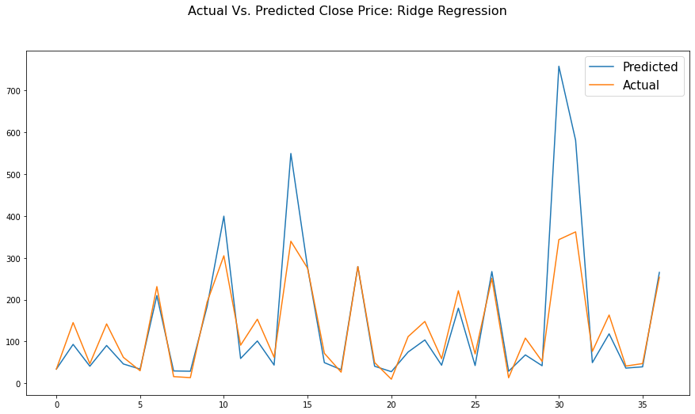
3. ridge Regression:
Ridge regression is a model-tuning method that is used to analyze any data that suffers from multicollinearity.
This method performs L2 regularization. When the issue of multicollinearity occurs, least-squares are unbiased, and variances are large, this results in predicted values being far away from the actual values.
mean absolute error: 16.91
mean squared error: 488.09
Root mean squared error: 22.09
r2_score: 0.97
mean absolute percentage error: 0.19

Slide 15
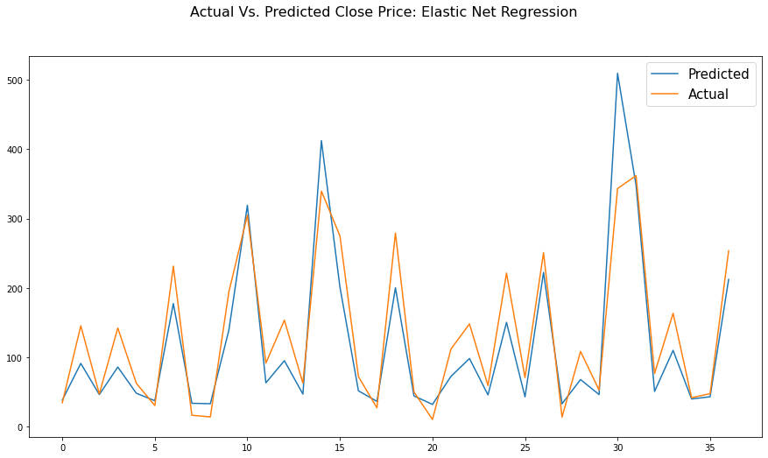
4. Elastic net regression:
Elastic net linear regression uses the penalties from both the lasso and ridge techniques to regularize regression models.
The technique combines both the lasso and ridge regression methods by learning from their shortcomings to improve the regularization of statistical models.
mean absolute error: 18.34
mean squared error: 726.63
Root mean squared error: 26.96
r2_score: 0.95
mean absolute percentage error: 0.16

Slide 16
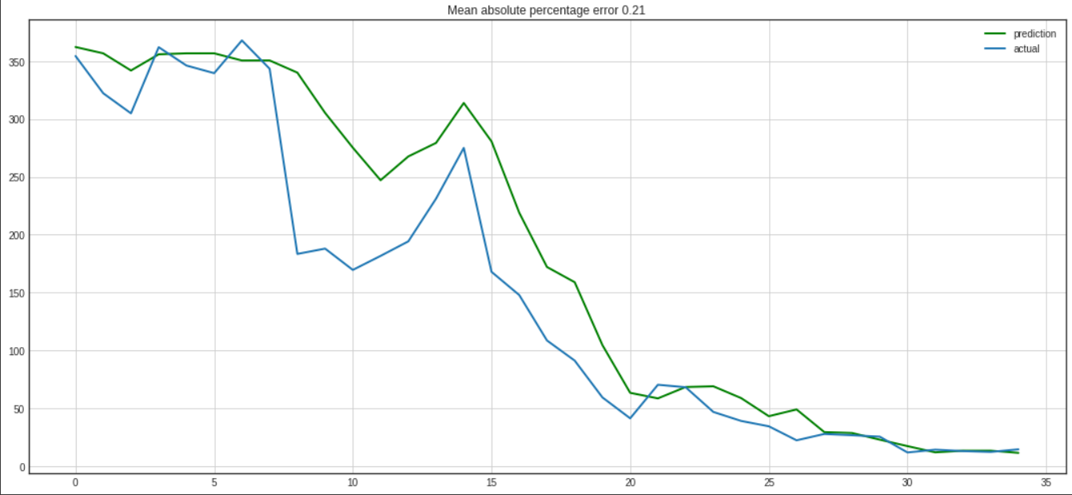
5. Xg boost regression:
XGBoost, which stands for Extreme Gradient Boosting, is a scalable, distributed gradient-boosted decision tree (GBDT) machine learning library.
It provides parallel tree boosting and is the leading machine-learning library for regression, classification, and ranking problems.
Best score: 66.07007559384817
Best parameters:
{'colsample_bytree': 0.8,
'max_depth': 15,
'n_estimators': 400,
'reg_alpha': 1.1,
'reg_lambda': 1.1,
'subsample': 0.8}

Slide 17
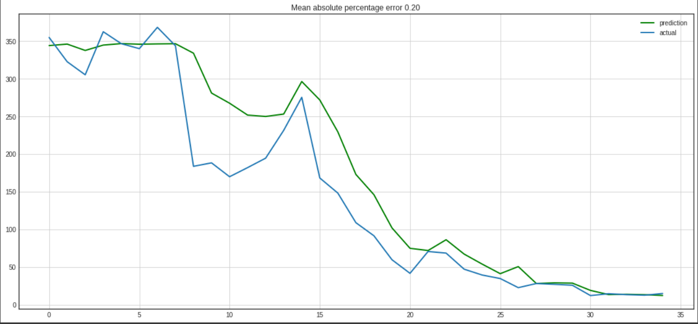
6. Random forest regression:
A random forest is a meta-estimator that fits a number of classifying decision trees on various sub-samples of the dataset and uses averaging to improve the predictive accuracy and control over-fitting.
Best score: 58.36378005674934
Best parameters: {'max_depth': 50, 'n_estimators': 100}

Slide 18
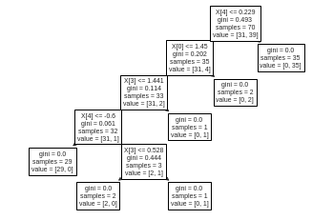
7. Decision tree:
A decision tree is a non-parametric supervised learning algorithm, which is utilized for both classification and regression tasks. It has a hierarchical, tree structure, which consists of a root node, branches, internal nodes, and leaf nodes.
Gini: 0.4934693877551021
Accuracy is: 0.8666666666666667

Slide 19
Evaluation Matric Of All Models
Linear Regression | 16.93 | 486.35 | 22.05 | 0.97 | 0.19
Ridge Regression (CV) | 16.91 | 488.09 | 22.09 | 0.97 | 0.19
Lasso Regression (CV) | 16.87 | 626.48 | 25.03 | 0.96 | 0.16
Elastic Net Regression (CV) | 18.34 | 726.63 | 26.96 | 0.95 | 0.16
MODEL
MAE
MSE
RMSE
R2_SCORE
MAPE

Slide 20
Thank you
Conclusions:
We started with data inspection, check the data distribution, checked for correlation, and used averaged features to remove correlation.
A simple Linear Regression model was built and it was evaluated using accuracy, mean squared error, root mean squared error, r2_score, and mean absolute percentage error.
Additional features were engineered by taking lags and reducing the effect of multi-collinearity using regularization techniques such as Ridge, Lasso, and Elastic Net regression.
Regression models namely Random Forest Regressor, XGBoots Regressor, Decision Tree, and Elastic Net Regression were built.
The time component was brought in and used averaging techniques like moving average, exponentially weighted moving average, and double exponentially weighted moving average to do time-series analysis.
Presence of non-stationarity was detected, making it stationary by taking lags and difference transformation and building an ARIMA model.

Slide 21


THANK YOU
MD KAMRAN
md.codekamran98@gmail.com
GitHub Link: https://github.com/md-kamran98

